Slide 1

Week 14: Reflections + Assignment work
Dr Ian Hussey
29/05/2024

Slide 2
Course reflections
Sincere thanks for being willing to do a new, demanding course.
Your feedback have improved it
Future students will hopefully benefit
I’m eager to teach it!

Slide 3
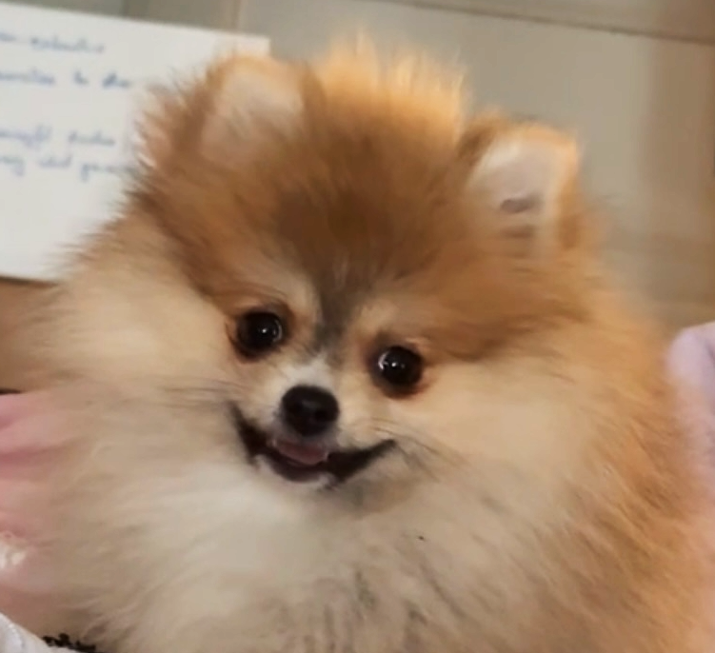
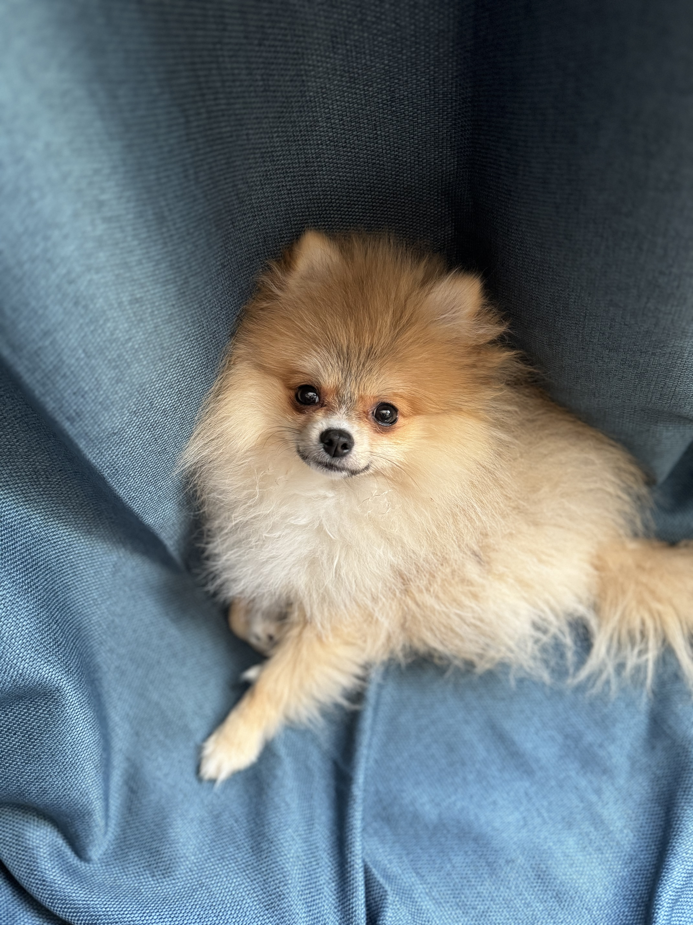
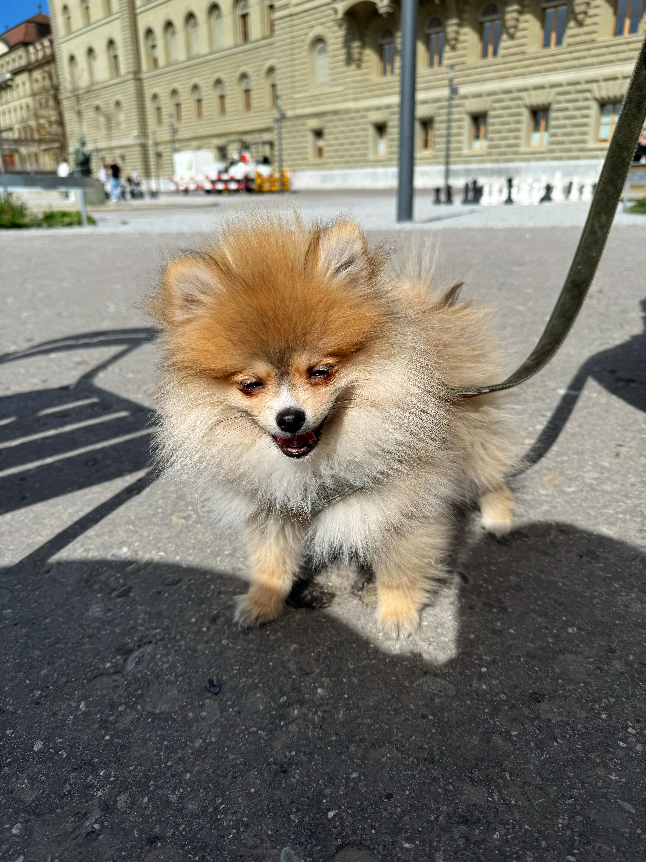
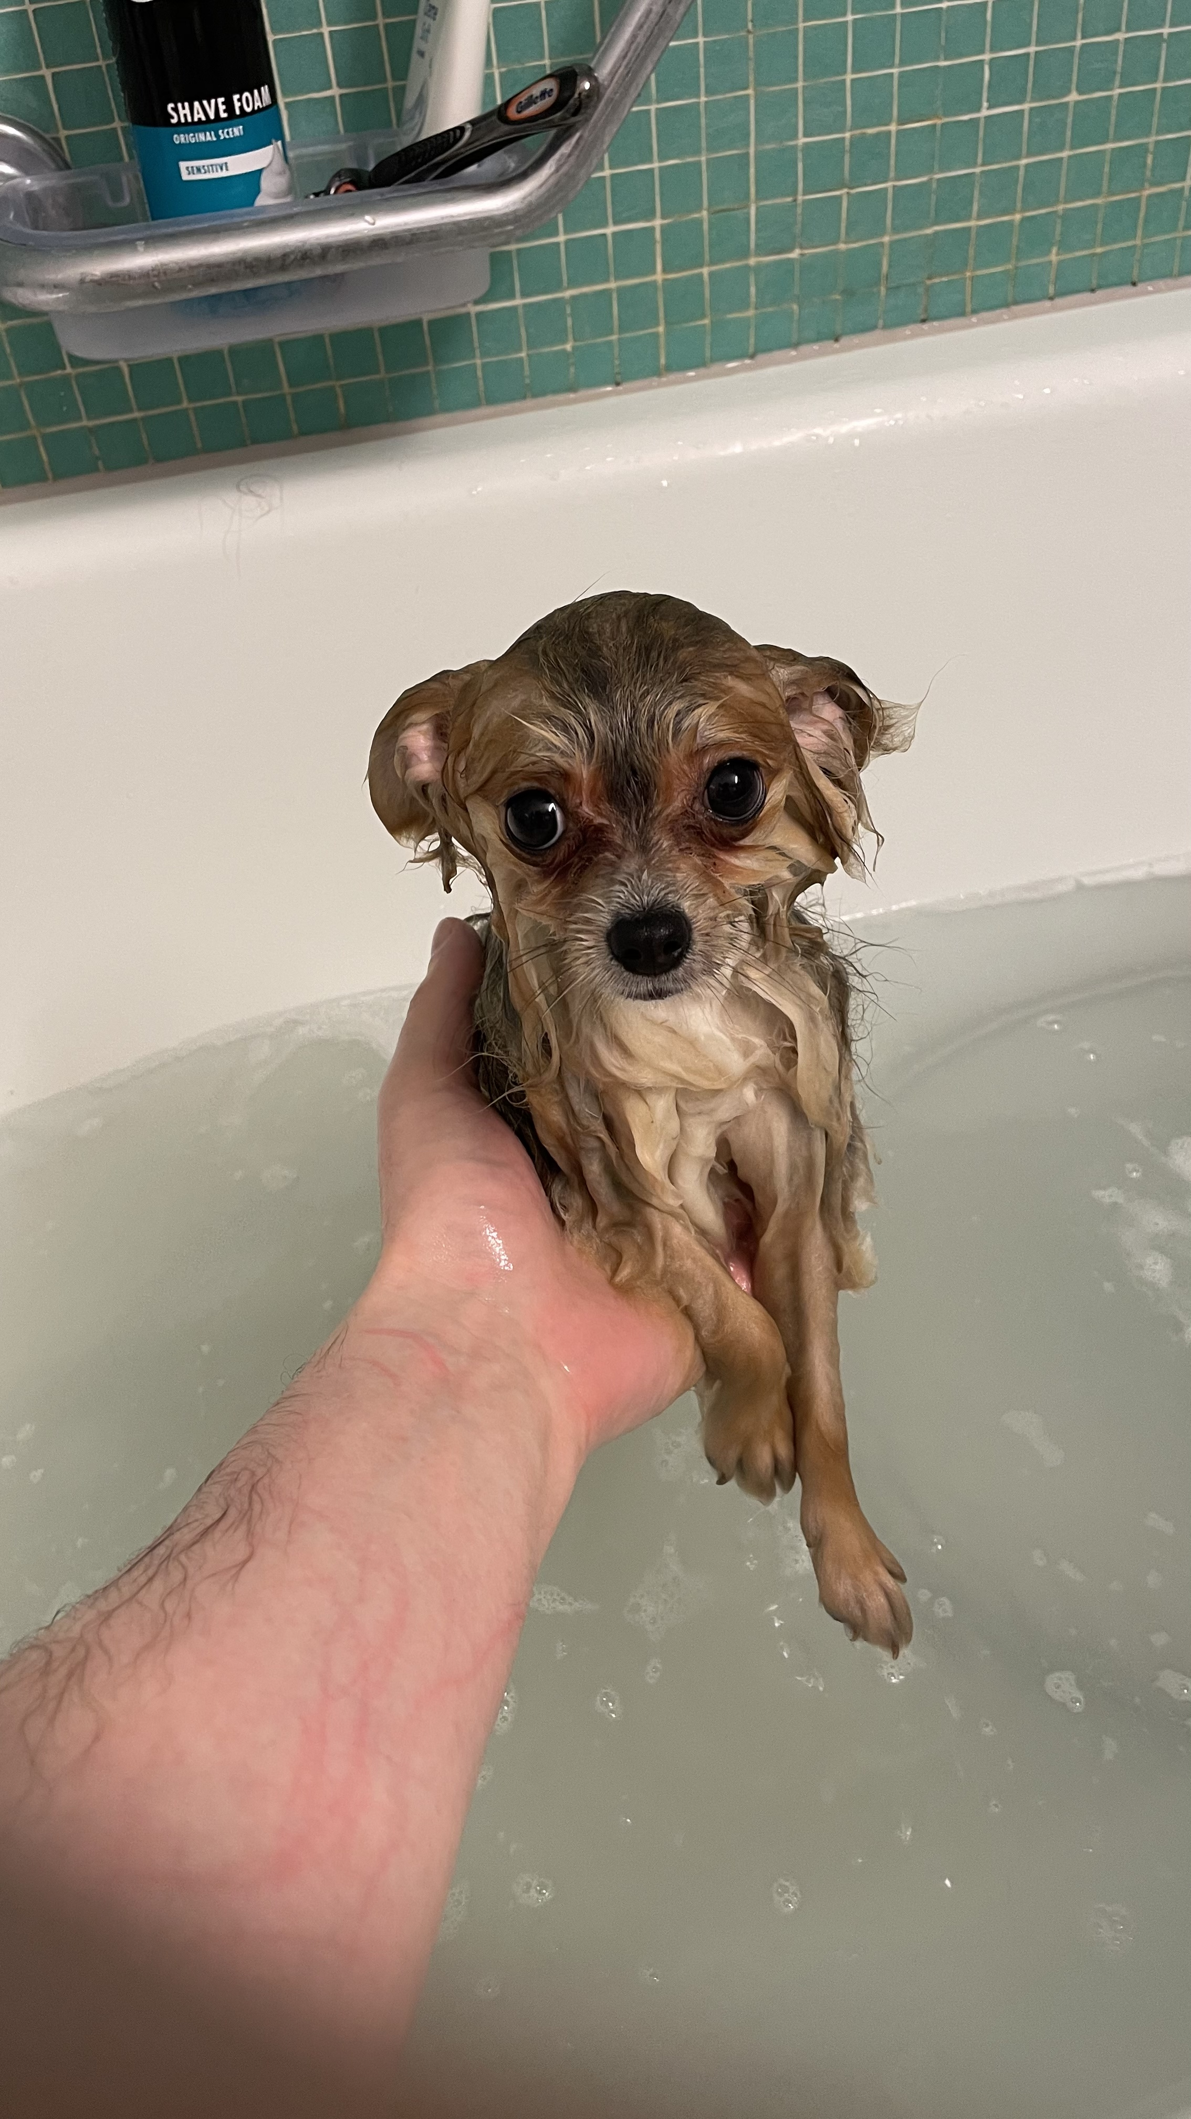
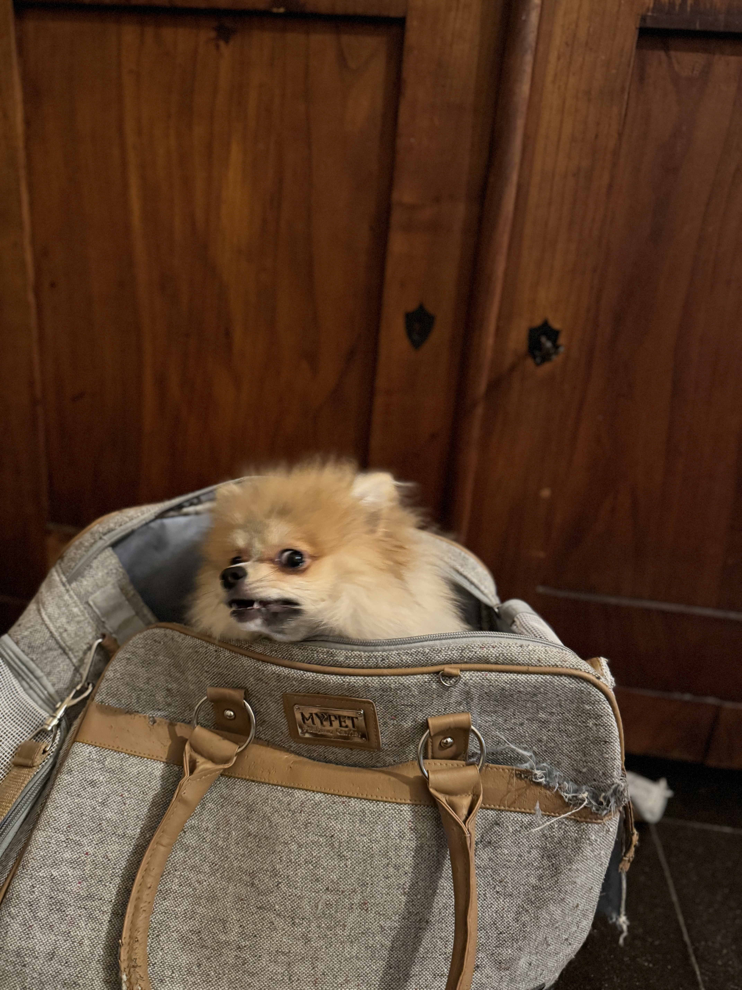
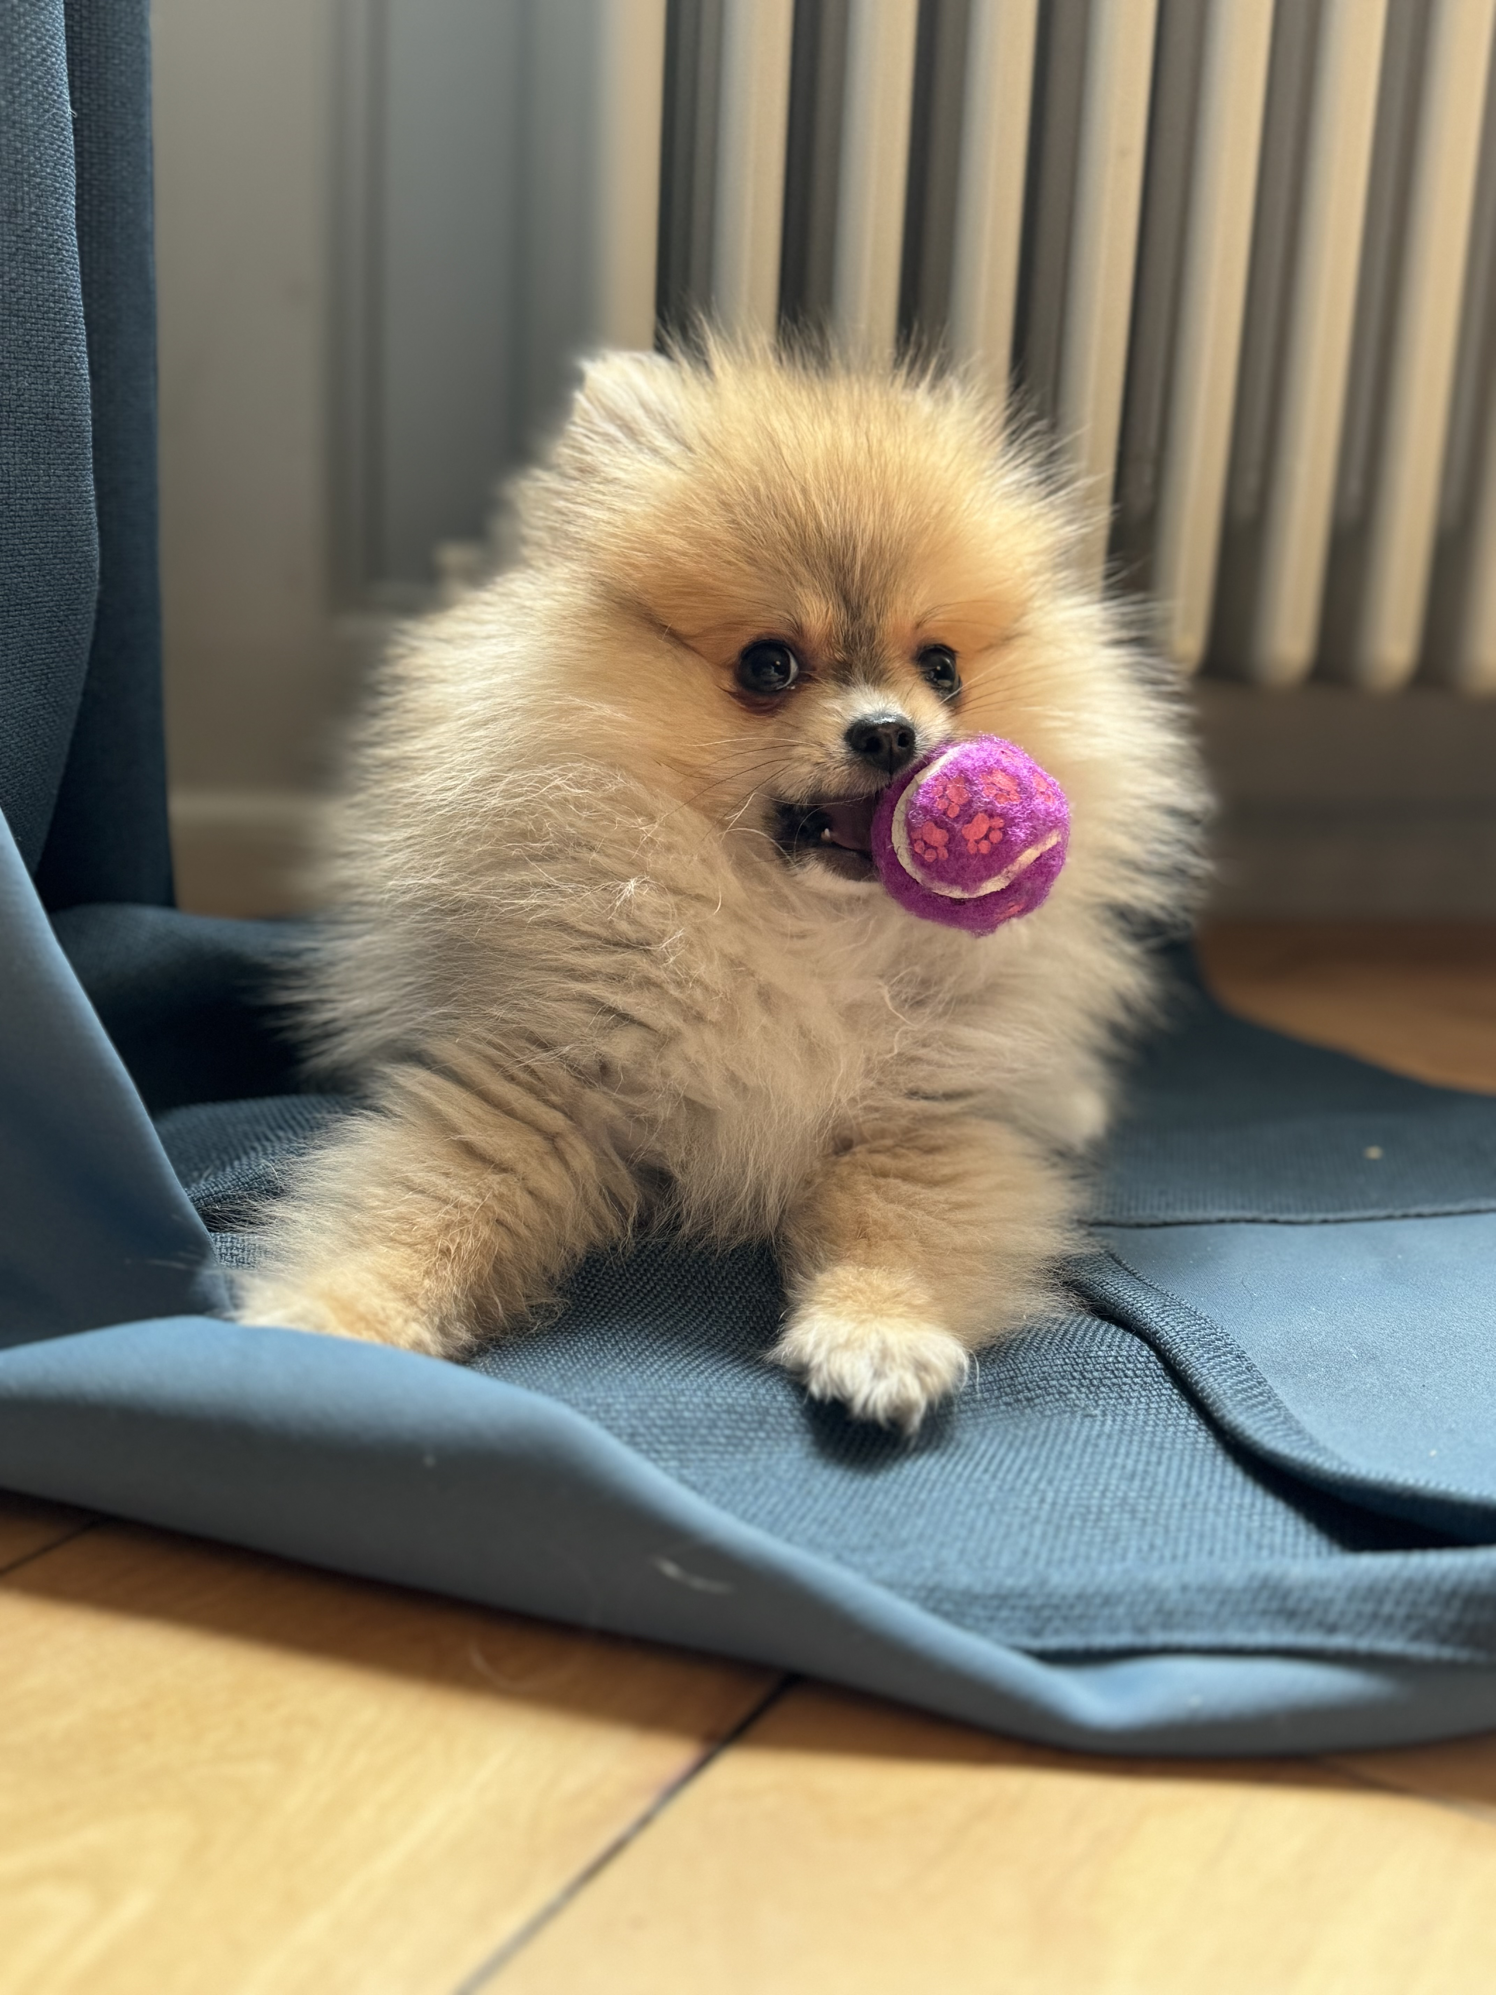
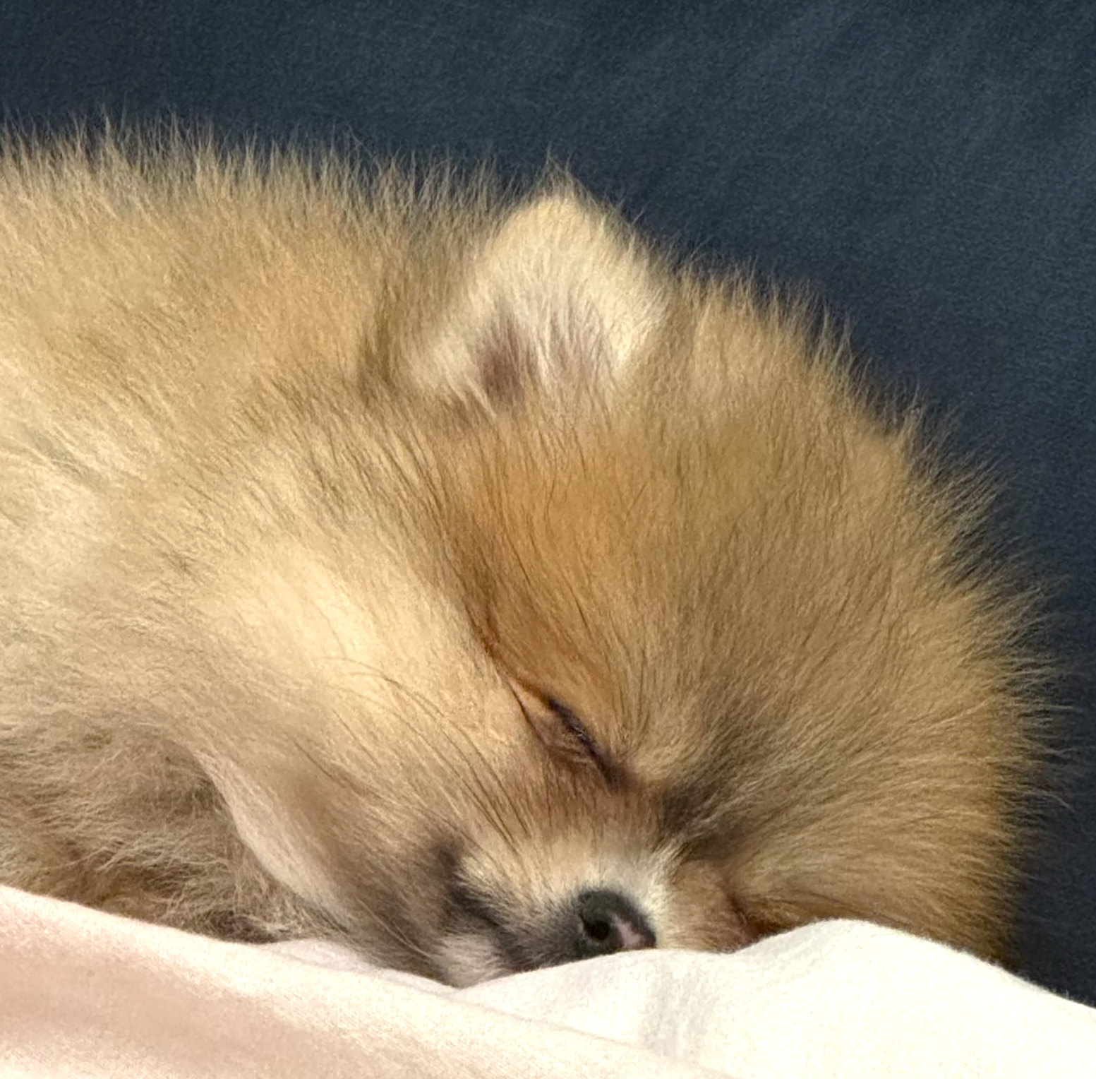
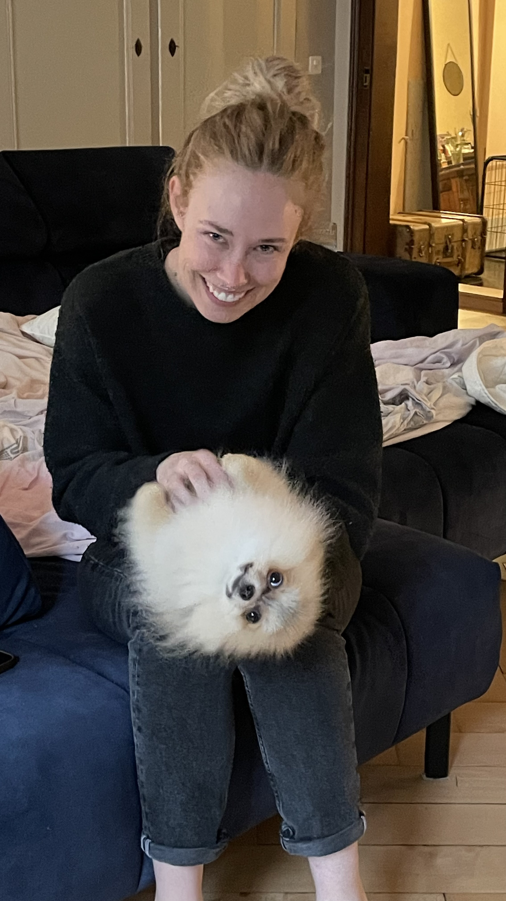
With exams and assignments coming up, which Rummy are you today?
1
2
3
4
5
6
7
8

Slide 4
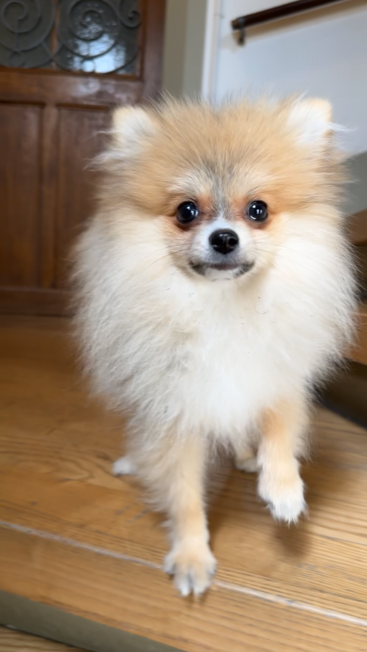
Course reflections
What did you feel was most useful?
What did you want to hear more of?
Do you want to discuss something more now?
What less?
My planned changes for the future
One-at-a-time simulations at the start; multiverse plots
Re-order the topics done on each week
More extensive reading list and syllabus
Refined the assignments
Guest lecturer:
Dr Rummy Borkington

